Slide 1


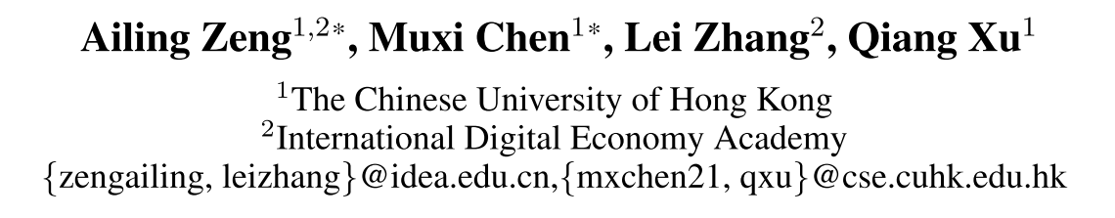
Are Transformers Effective for Time Series Forecasting?
AAAI 2023
2024 / 03 / 13

Slide 2

01
Background
In time series modeling, we are to extract the temporal relations in an ordered set of continuous points. While employing positional encoding and using tokens to embed sub-series in Transformers facilitate preserving some ordering information, the nature of the permutationin variant self-attention mechanism inevitably results in temporal information loss.
Permutation-invariant
The semantic meaning of a sentence is largely preserved even if we reorder some words in it. However, when analyzing time series data, there is usually a lack of semantics in the numerical data itself, and we are mainly interested in modeling the temporal changes among a continuous set of points.
汉字的序顺并不定一能影阅响读
知行合一、经世致用
自强不息 厚德载物
Tsinghua University of China
Central South University
Notes:
然而，在时间序列建模中，我们要提取连续点的有序集合中的时间关系。虽然采用位置编码和使用令牌嵌入子系列的变压器有利于保持一些排序信息，permutationinvariant自注意机制的性质不可避免地导致时间信息丢失。
尽管我们对句子中的某些词进行了重新排序，但句子的语义在很大程度上得到了保留。2然而，在分析时间序列数据时，数字数据本身通常缺乏语义，我们主要感兴趣的是对连续点集之间的时间变化进行建模。

Slide 3
01
Background
Time Series Forecasting (TSF)
Iterated Multi-Step(IMS) forecasting
Smaller variance
Error accumulation effects
Suitable when forecasting time step 'T is relatively small
Direct Multi-Step(DMS) forecasting
Suitable when 'T is large
Focus on Long Time Series Forecasting
Long-term forecasting is only feasible for those time series with a relatively clear trend and periodicity.
知行合一、经世致用
自强不息 厚德载物
Tsinghua University of China
Central South University
Notes:
长期预测只适用于趋势性和周期性较明显的时间序列。

Slide 4
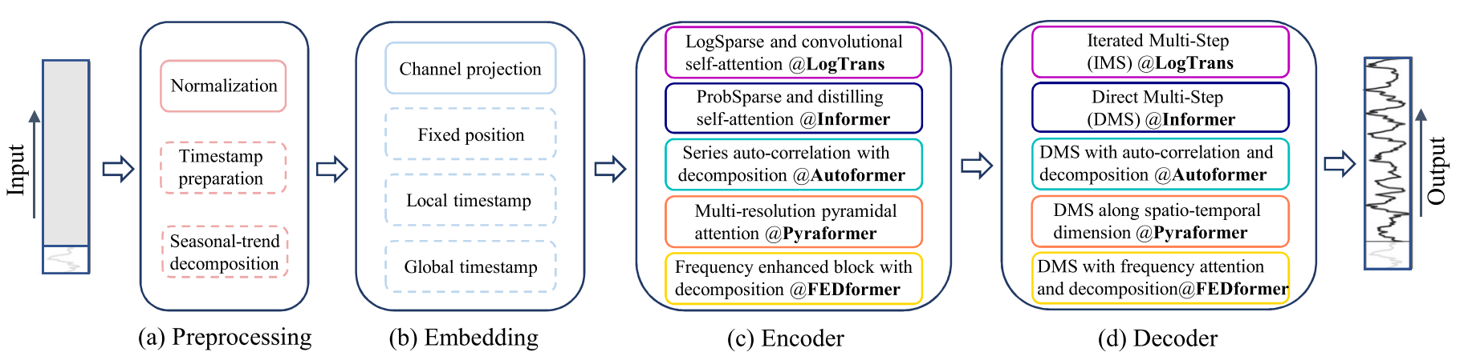
02
Related Work
LogTrans (Li et al. 2019) (NeurIPS 2019)
Informer (Zhou et al. 2021) (AAAI 2021 Best paper)
Autoformer (Xu et al. 2021) (NeurIPS 2021)
Pyraformer (Liu et al. 2021a) (ICLR 2022 Oral)
Triformer (Cirstea et al. 2022) (IJCAI 2022)
FEDformer (Zhou et al. 2022) (ICML 2022)
In the experiments of existing Transformer-based LTSF solutions (T ≫ 1), all the compared (non-Transformer) baselines are IMS forecasting techniques, which are known to suffer from significant error accumulation effects. We hypothesize that the performance improvements in these works are largely due to the DMS strategy used in them.
知行合一、经世致用
自强不息 厚德载物
Tsinghua University of China
Central South University
Notes:
在现有的基于Transformer的LTSF解决方案的实验中（T 1），所有比较的（非Transformer）基线都是IMS预测技术，已知这些技术会受到显著的误差累积效应的影响。我们假设，在这些作品中的性能提高，在很大程度上是由于在他们使用的DMS策略。

Slide 5
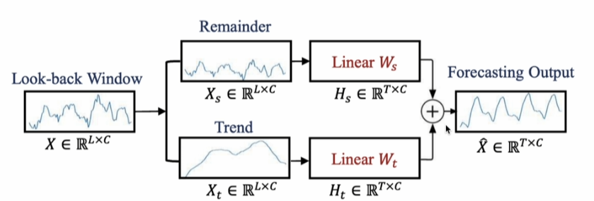
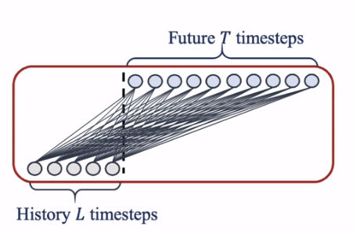
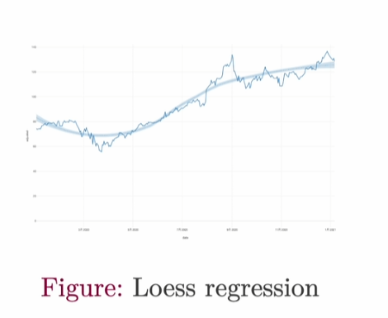
03
Methodology
An Embarrassingly Simple Baseline for LTSF
DLinear
Clear trend
NLinear
Distribution shift
NLinear first subtracts the input by the last value of the sequence. Then, the input goes through a linear layer, and the subtracted part is added back before making the final prediction.
知行合一、经世致用
自强不息 厚德载物
Tsinghua University of China
Central South University

Slide 6
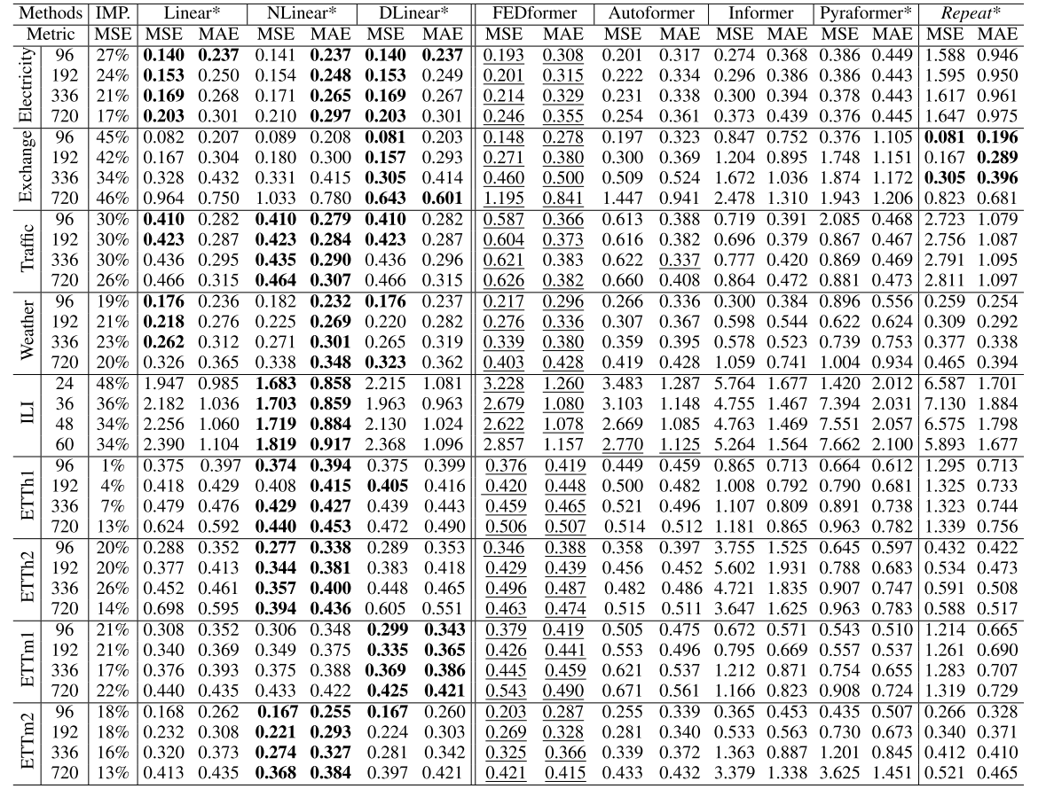
04
Result
Multivariate long-term forecasting errors in terms of MSE and MAE, the lower the better. Among them, ILI dataset is with forecasting horizon T ∈ {24, 36, 48, 60}. For the others, T ∈ {96, 192, 336, 720}. The best results are highlighted in bold and the best results of Transformers are highlighted with an underline. IMP. is the best result of linear models compared to the results of Transformer-based solutions.
知行合一、经世致用
自强不息 厚德载物
Tsinghua University of China
Central South University
Notes:
多变量长期预测误差的MSE和MAE，越低越好。其中，ILI数据集的预测范围T ∈ {24，36，48，60}。对于其他人，T ∈ {96，192，336，720}。最佳结果以粗体突出显示，而变形金刚的最佳结果以下划线突出显示。IMP.是线性模型的最佳结果，与基于转换器的解决方案的结果相比。

Slide 7
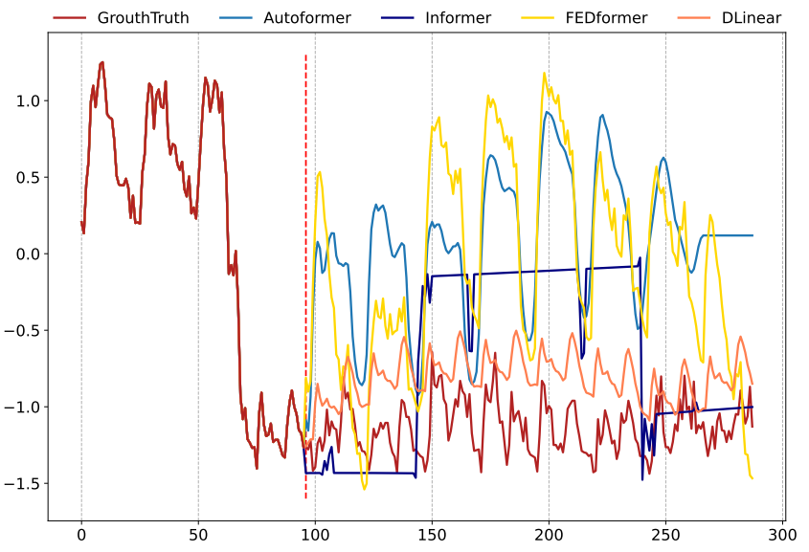
04
Result
Illustration of the long-term forecasting outputs (Y-axis) of five models with an input length L=96 and output length T=192 (X-axis) on Electricity.
知行合一、经世致用
自强不息 厚德载物
Tsinghua University of China
Central South University

Slide 8
05
More Analyses
Can existing LTSF-Transformers extract temporal relations well from longer input sequences?
What can be learned for long-term forecasting?
Are the self-attention scheme effective for LTSF?
Can existing LTSF-Transformers preserve temporal or der well?
How effective are different embedding strategies?
Is training data size a limiting factor for existing LTSF Transformers?
Is efficiency really a top-level priority?
知行合一、经世致用
自强不息 厚德载物
Tsinghua University of China
Central South University
Notes:
现有的LTSF变换器可以从较长的输入序列中提取时间关系吗？
从长期预测中可以学到什么？
自我注意机制对LTSF有效吗？
现有的LTSF变压器能很好地保存时间或时间吗？
不同的嵌入策略效果如何？
训练数据大小是否是现有LTSF Transformer的限制因素？
效率真的是头等大事吗？

Slide 9
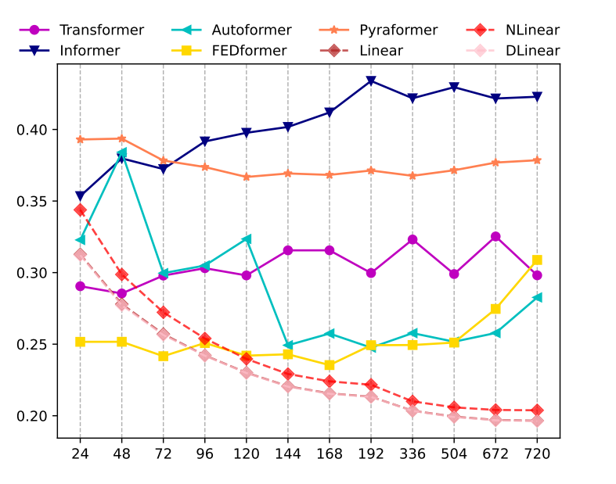
05
More Analyses
Can existing LTSF-Transformers extract temporal relations well from longer input sequences?
When the look-back window size increases. In contrast, the performances of all LTSF-Linear are significantly boosted with the increase of look-back window size. Thus, existing solutions tend to overfit temporal noises instead of extracting temporal information if given a longer sequence, and the input size 96 is exactly suitable for most Transformers.
The MSE results (Y-axis) of models with different look-back window sizes (X-axis) of long-term forecasting (T=720) on Electricity.
知行合一、经世致用
自强不息 厚德载物
Tsinghua University of China
Central South University
Notes:
当回看窗口大小增加时，现有变压器的性能会下降或保持稳定。相比之下，所有LTSF-Linear的性能显着提高与回看窗口大小的增加。因此，如果给定较长的序列，现有的解决方案倾向于过拟合时间噪声而不是提取时间信息，并且输入大小96完全适合于大多数变压器。
电力长期预测（T=720）的不同回看窗口大小（X轴）模型的MSE结果（Y轴）。

Slide 10
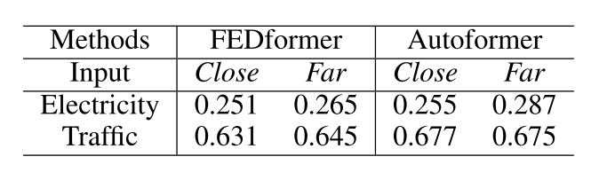
05
More Analyses
What can be learned for long-term forecasting?
The performance of the SOTA Transformers drops slightly, indicating these models only capture similar temporal information from the adjacent time series sequence. Since capturing the intrinsic characteristics of the dataset generally does not require a large number of parameters, i,e. one parameter can represent the periodicity. Using too many parameters will even cause overfitting.
Hypothesize that long-term forecasting depends on whether models can capture the trend and periodicity well only.
知行合一、经世致用
自强不息 厚德载物
Tsinghua University of China
Central South University
Notes:
我们假设长期预测仅取决于模型能否很好地捕捉趋势和周期。 SOTA Transformers的性能略有下降，表明这些模型仅从相邻的时间序列序列中捕获相似的时间信息。由于捕获数据集的内在特征通常不需要大量的参数，即，一个参数可以表示周期性。使用太多的参数甚至会导致过拟合。

Slide 11
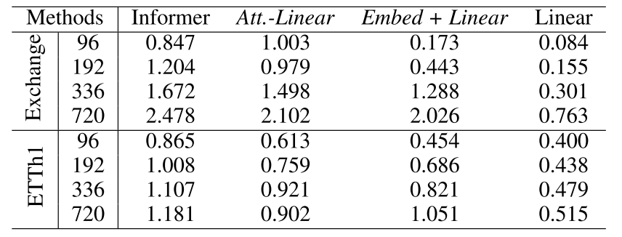
05
More Analyses
Are the self-attention scheme effective for LTSF?
Replace each self-attention layer with a linear layer, called Att.-Linear
Discard other auxiliary designs (e.g., FFN) in Informer to leave embedding layers and linear layers, named Embed + Linear.
知行合一、经世致用
自强不息 厚德载物
Tsinghua University of China
Central South University

Slide 12
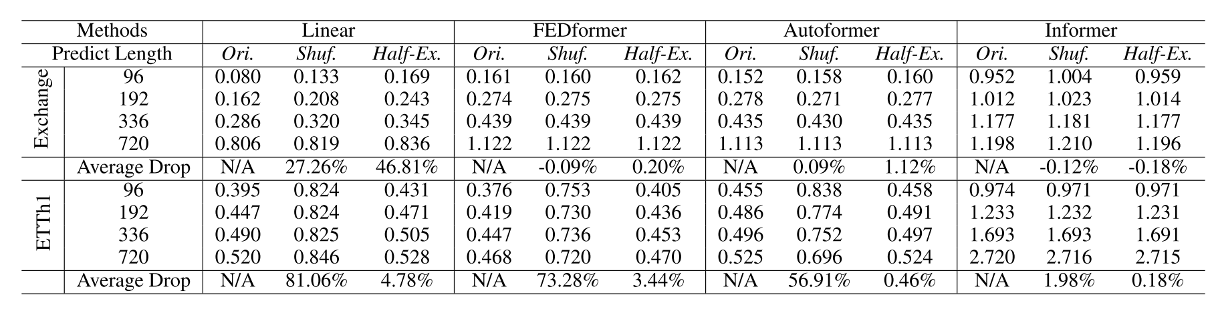
05
More Analyses
Can existing LTSF-Transformers preserve temporal or der well?
Shuf. randomly shuffles the whole input sequences
Half-Ex. exchanges the first half of the input sequence with the second half.
知行合一、经世致用
自强不息 厚德载物
Tsinghua University of China
Central South University
Notes:
现有的LTSF变压器能否很好地保持时间或顺序？ 多变量长期预测误差的MSE和MAE，越低越好。其中，ILI数据集的预测范围T ∈ {24，36，48，60}。对于其他人，T ∈ {96，192，336，720}。最佳结果以粗体突出显示，而变形金刚的最佳结果以下划线突出显示。IMP.是线性模型的最佳结果，与基于转换器的解决方案的结果相比。

Slide 13
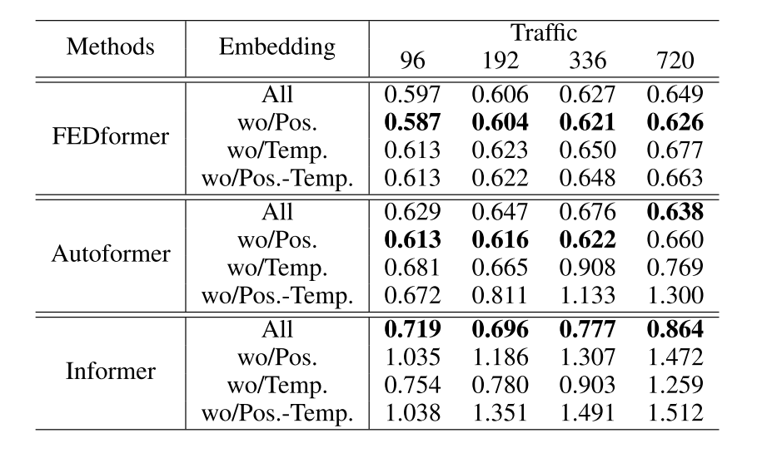
05
More Analyses
How effective are different embedding strategies?
The forecasting errors of Informer largely increase without positional embeddings (wo/Pos.). Without timestamp embeddings (wo/Temp.) will gradually damage the performance of Informer as the forecasting lengths increase. Since Informer uses a single time step for each token, it is necessary to introduce temporal information in tokens. Rather than using a single time step in each token, FEDformer and Autoformer input a sequence of timestamps to embed the temporal information. Hence, they can achieve comparable or even better performance without fixed positional embeddings. However, without timestamp embeddings, the performance of Autoformer declines rapidly because of the loss of global temporal information. Instead, thanks to the frequency-enhanced module proposed in FEDformer to introduce temporal inductive bias, it suffers less from removing any position/timestamp embeddings.
知行合一、经世致用
自强不息 厚德载物
Tsinghua University of China
Central South University
Notes:
在表6中，Informer的预测误差在没有位置嵌入的情况下大幅增加（wo/Pos.）。无时间戳嵌入（无/温度）将随着预测长度的增加逐渐损害Informer的性能。由于Informer对每个令牌使用单个时间步长，因此有必要在令牌中引入时间信息。FEDformer和Autoformer不是在每个令牌中使用单个时间步长，而是输入一系列时间戳来嵌入时间信息。因此，它们可以在没有固定位置嵌入的情况下实现相当甚至更好的性能。然而，如果没有时间戳嵌入，Autoformer的性能迅速下降，因为失去了全局的时间信息。相反，由于在FED former中提出的频率增强模块引入了时间感应偏置，它在去除任何位置/时间戳嵌入时受到的影响较小。

Slide 14
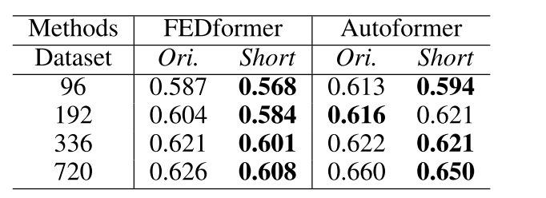
05
More Analyses
Is training data size a limiting factor for existing LTSFTransformers?
Ori. (17,544*0.7hours)
Short (8,760 hours, i.e., 1 year)
While we cannot conclude that we should use fewer data for training, it demonstrates that the training data scale is not the limiting reason.
知行合一、经世致用
自强不息 厚德载物
Tsinghua University of China
Central South University
Notes:
虽然我们不能得出结论，我们应该使用更少的数据进行训练，但它表明训练数据规模不是限制性的原因。

Slide 15
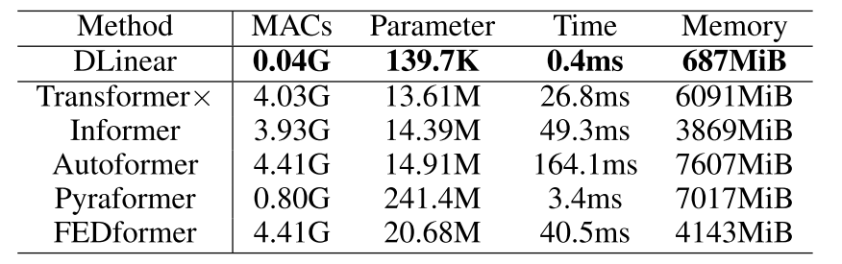
05
More Analyses
Is efficiency really a top-level priority?
Most Transformer variants incur similar or worse inference time and parameters in practice. These follow-ups introduce more additional design elements to make practical costs high.
知行合一、经世致用
自强不息 厚德载物
Tsinghua University of China
Central South University
Notes:
大多数Transformer变体在实践中导致类似或更差的推理时间和参数。这些后续工作引入了更多的附加设计元素，使实际成本很高。

Slide 16
06
Conclusion
Transformers are not effective for Time Series Forecasting
With the above, we conclude that the temporal modeling capabilities of Transformers for time series are exaggerated, at least for the existing LTSF benchmarks.
With our findings, we also advocate revisiting the validity of Transformer-based solutions for other time series analysis tasks (e.g., anomaly detection) in the future.
知行合一、经世致用
自强不息 厚德载物
Tsinghua University of China
Central South University
Notes:
通过以上内容，我们得出结论，转换器对时间序列的时间建模能力被夸大了，至少对于现有的LTSF基准来说是这样。
根据我们的发现，我们还主张重新审视基于变压器的解决方案在未来其他时间序列分析任务（如异常检测）中的有效性。

Slide 17


谢 谢 大 家
THANKS FOR ALL

